Slide 1



AI Master Class series – Day 15
Character Recognition using CNN

Slide 2
Installing Libraries
PyQt5: pip install PyQt5

Slide 3
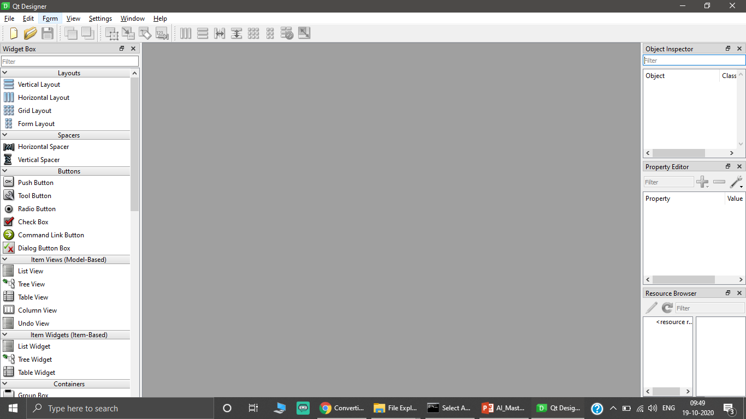
PyQt Designer - BONUS
designer

Slide 4
Designer to Python Program
python -m PyQt5.uic.pyuic -x [FILENAME].ui -o [FILENAME].py

Slide 5
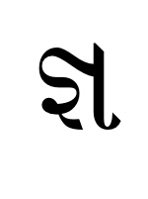
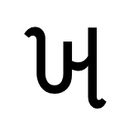
Character Recognition.
For unknown language character or symbol can be trained using deep learning to recognize it for different purpose
It can be also used to recognize the numbers for application such as number plate recognition etc.

Slide 6
Block Diagram – Workflow of Leaf disease detection.
Dataset Creation
Train, Test, Val
CNN Design
Pre-Processing
Training - Model
Load Model - Test
Pre-process Input Image
Classification

Slide 7

! PRACTICAL SESSION !
Gujarati Character Recognition

Slide 8
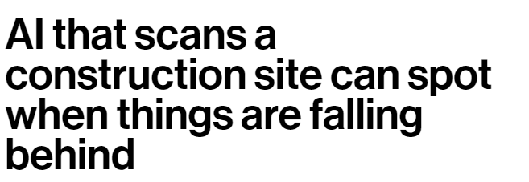
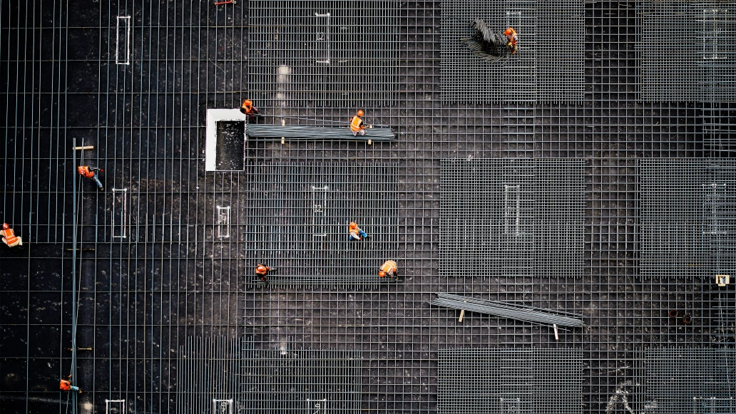
AI News – Day 15. 2020
Building sites in Europe are now using image recognition software made by Buildots that flags up delays or errors automatically.

Slide 9
Thanks!
Tomorrow session
Do you have any questions?
sanjay@pantechmail.com
www.pantechsolutions.net
Optical Character Recognition

Slide 10
Day-14 Agenda.
01.
02.
03.
Character Recognition
PYQT
Guajarati character recognition
04.
Q & A
Character Recognition for other Language
Designer
Application with GUI

